Slide 1
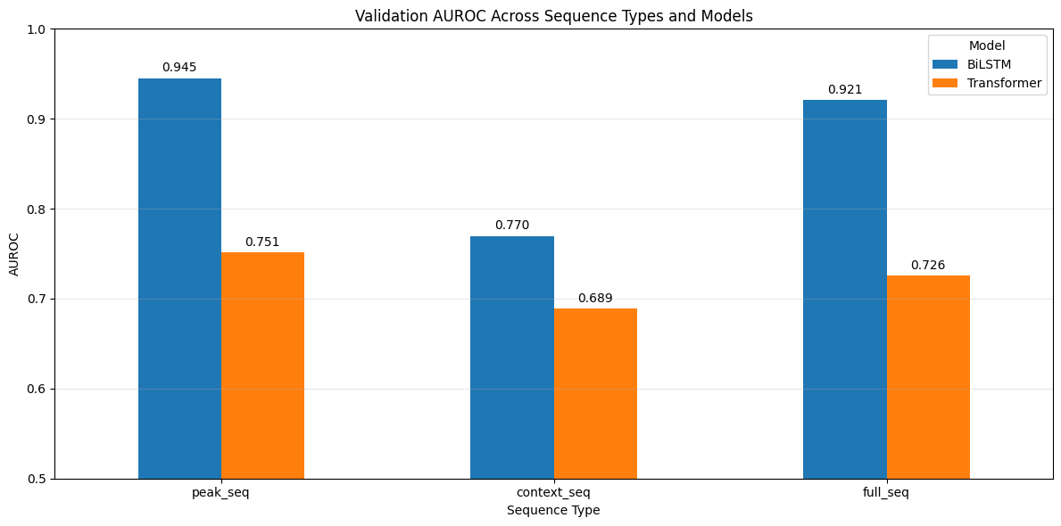
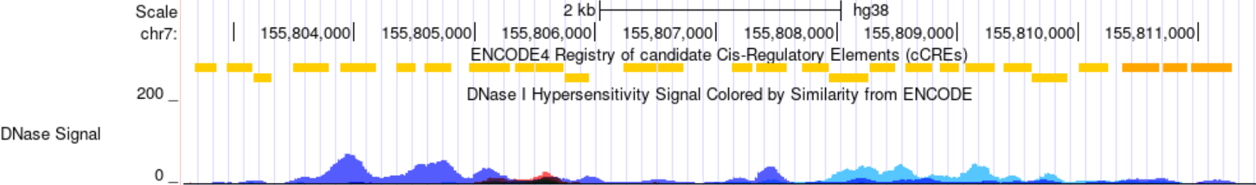
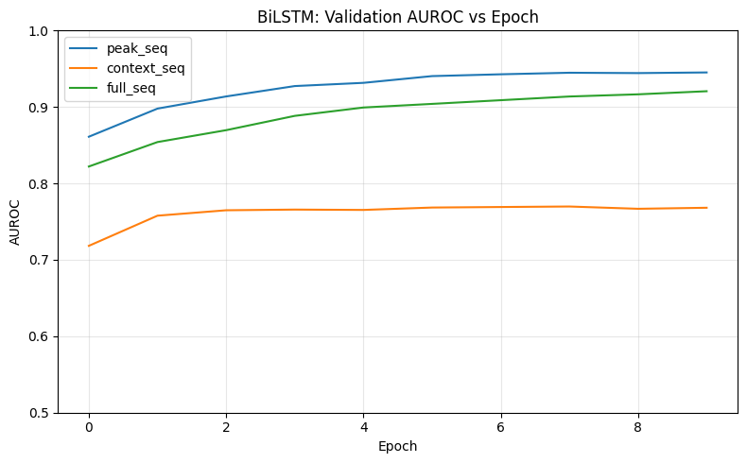
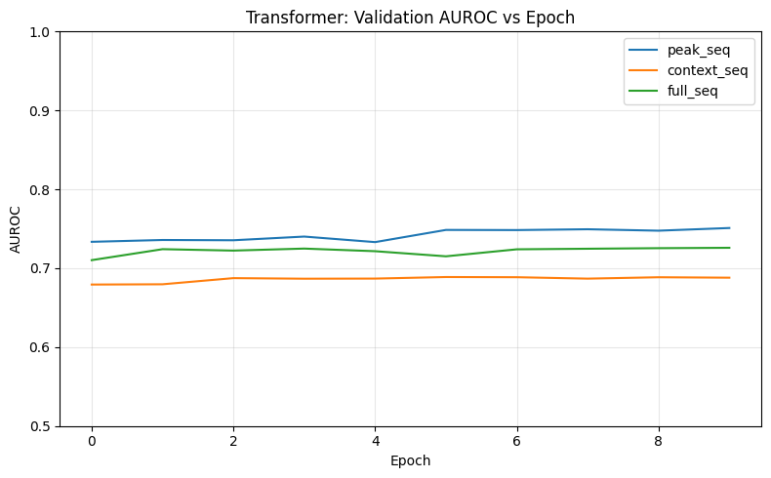
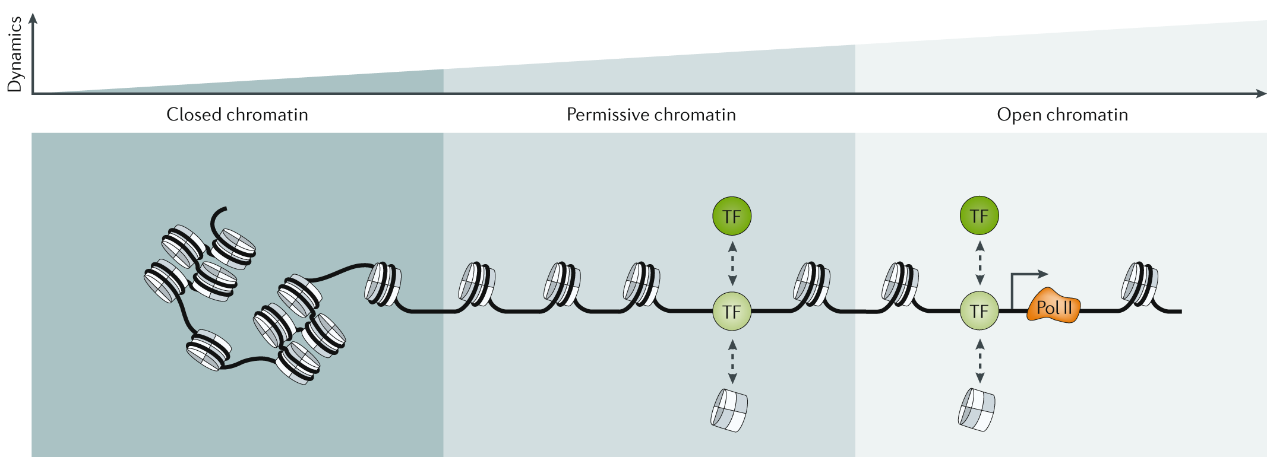
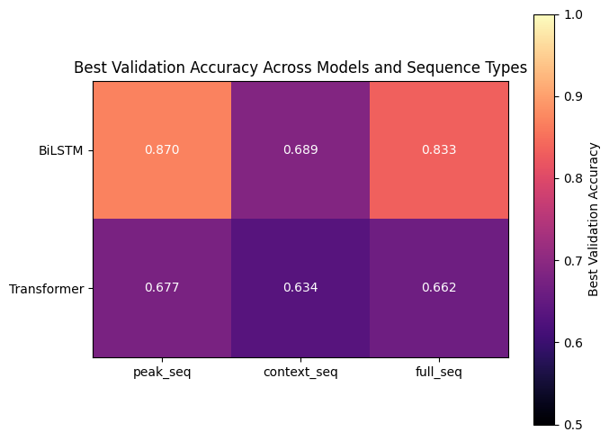
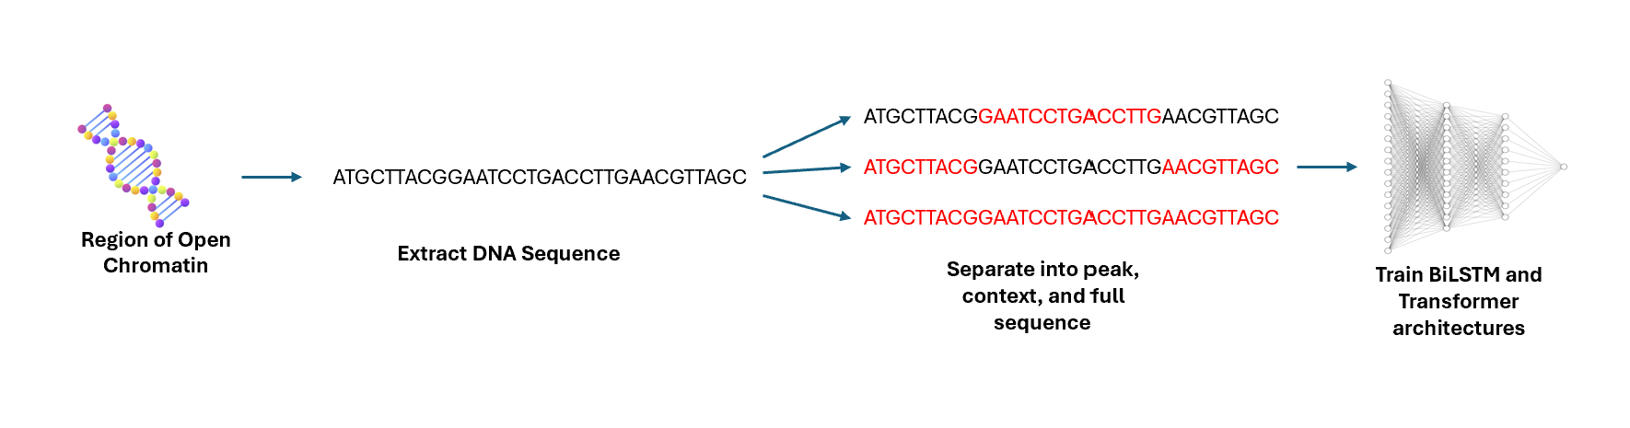
Regulatory DNA Prediction from Peak and Context Sequences Using BiLSTMs and Transformers
Connor Nguyen
CSE 493G1 Spring 2026
BACKGROUND & MOTIVATION
EXPERIMENTAL RESULTS
Background
Regulatory DNA consists of DNA regions that control when and where genes are turned on or off. Examples include promoters and enhancers, which help regulate gene expression.
Deep learning models are becoming increasingly prevalent in identifying these regulatory regions directly from DNA sequences.
Model Comparison
The task is effectively reduced to a binary classification problem: given a DNA sequence, predict whether or not it corresponds to a regulatory region.
Motivation
Modern genomic models have achieved strong predictive performances; however, their architectures often operate as black boxes, making it unclear what biological data they rely on.
The regions surrounding core regulatory sequences may contain enough information for models to infer regulatory activity without the core region present.
Analyzing whether models depend on true regulatory regions or contextual bias can improve interpretability and understanding in genomics machine learning.
Goal
Determine whether machine learning architectures can predict regulatory DNA activity using only surrounding genomic context.
BiLSTM
Bidirectional Long Short-Term Memory.
Captures sequential, short-range dependencies.
Struggles with long-range interactions.
Transformer
Modern standard.
Utilizes self-attention.
Better at capturing global context and parallelizable.
EXPERIMENTAL DESIGN
CONCLUSIONS & FUTURE WORK
DNase-seq experiments identify regions of open chromatin, or accessible DNA, which are often associated with active regulatory elements.
Regulatory DNA sequences were obtained from the ENCODE DNase-seq peak annotations mapped to the human reference genome (GRCh38).
For each regulatory region, the following was extracted:
the regulatory region itself (peak sequence)
the surrounding DNA (context sequence)
both regions combined (full sequence)
BiLSTM and Transformer models were trained on each input type to evaluate how much predictive information is contained within the genomic context alone.
Conclusions
Regulatory DNA can be predicted directly from DNA sequences using deep learning models.
Peak sequences produced the strongest performance, indicating that the primary regulatory signal lies within the regulatory region itself.
Context sequences alone remained predictive, suggesting the presence of contextual biases surrounding genomic features.
Model performance varied across architectures, revealing differences in how sequence information is learned.
Future Work
Investigate underperformance of Transformer model relative to BiLSTM and evaluate architectures specifically designed for genomic sequence modeling.
Explore larger models and longer input sequences to better capture long-range regulatory dependencies.
REFERENCES
[1] ENCODE Project Consortium. The ENCODE Project: Encyclopedia of DNA Elements in the Human Genome. https://www.encodeproject.org/
[2] Genome Reference Consortium. Human Genome Assembly GRCh38. https://www.ncbi.nlm.nih.gov/grc
[3] UCSC Genome Browser. Human Genome Browser on GRCh38. https://genome.ucsc.edu/
[4] Javed, N., Weingarten, T., Sehanobish, A. et al. A multi-modal transformer for cell type-agnostic regulatory predictions. Cell Genomics 5, 100762 (2025). https://doi.org/10.1016/j.xgen.2025.100762
[5] Avsec, Ž., Latysheva, N., Cheng, J. et al. Advancing regulatory variant effect prediction with AlphaGenome. Nature 649, 1206–1218 (2026). https://doi.org/10.1038/s41586-025-10014-0
[6] Pipoli, V., Cappelli, M., Palladini, A. et al. Predicting gene expression levels from DNA sequences and post-transcriptional information with transformers. Computer Methods and Programs in Biomedicine 225, 107035 (2022). https://doi.org/10.1016/j.cmpb.2022.107035

